Slide 1
Sviluppo ed implementazione di servizi per il confronto dei prodotti modellistici e delle misure ( Development and implementation of services for the comparison of modeling products and measurements )
CASCADE|PP4 | Alex Pividori
Palmanova | 28th September 2021

Slide 2
Table of contents:
Description of data: measured and CMEMS analysis
Description of samples stations used
TS-Diagrams, boxplots and mean values graphs
Future application and next analysis

Slide 3
Collected data: in-situ measures and CMEMS hindcast
In-situ measures
COPERNICUS Marine hindcast analysis
Time period:
from 01/2014 to 07/2021
Uniformly distributed in daily period (not at night)
Approximations
Time period:
download from 07/2020 to 07/2021
Hourly time-steps: from 00:30 to 23:30
Depth levels:
Not uniformly distributed levels.
First at 1,02 m,
Distance ≈ 2 m until 10 m
≈ 10 m for deeper values
Depth levels:
0,25 m interval. Starting from 0,25 m to bottom
Analysis place:
Stations distributed in the Marano-Grado lagoon, in the Trieste Gulf and near the coasts
Data spatial distribution:
Regular grid 0,0416° x 0,0416°

Slide 4
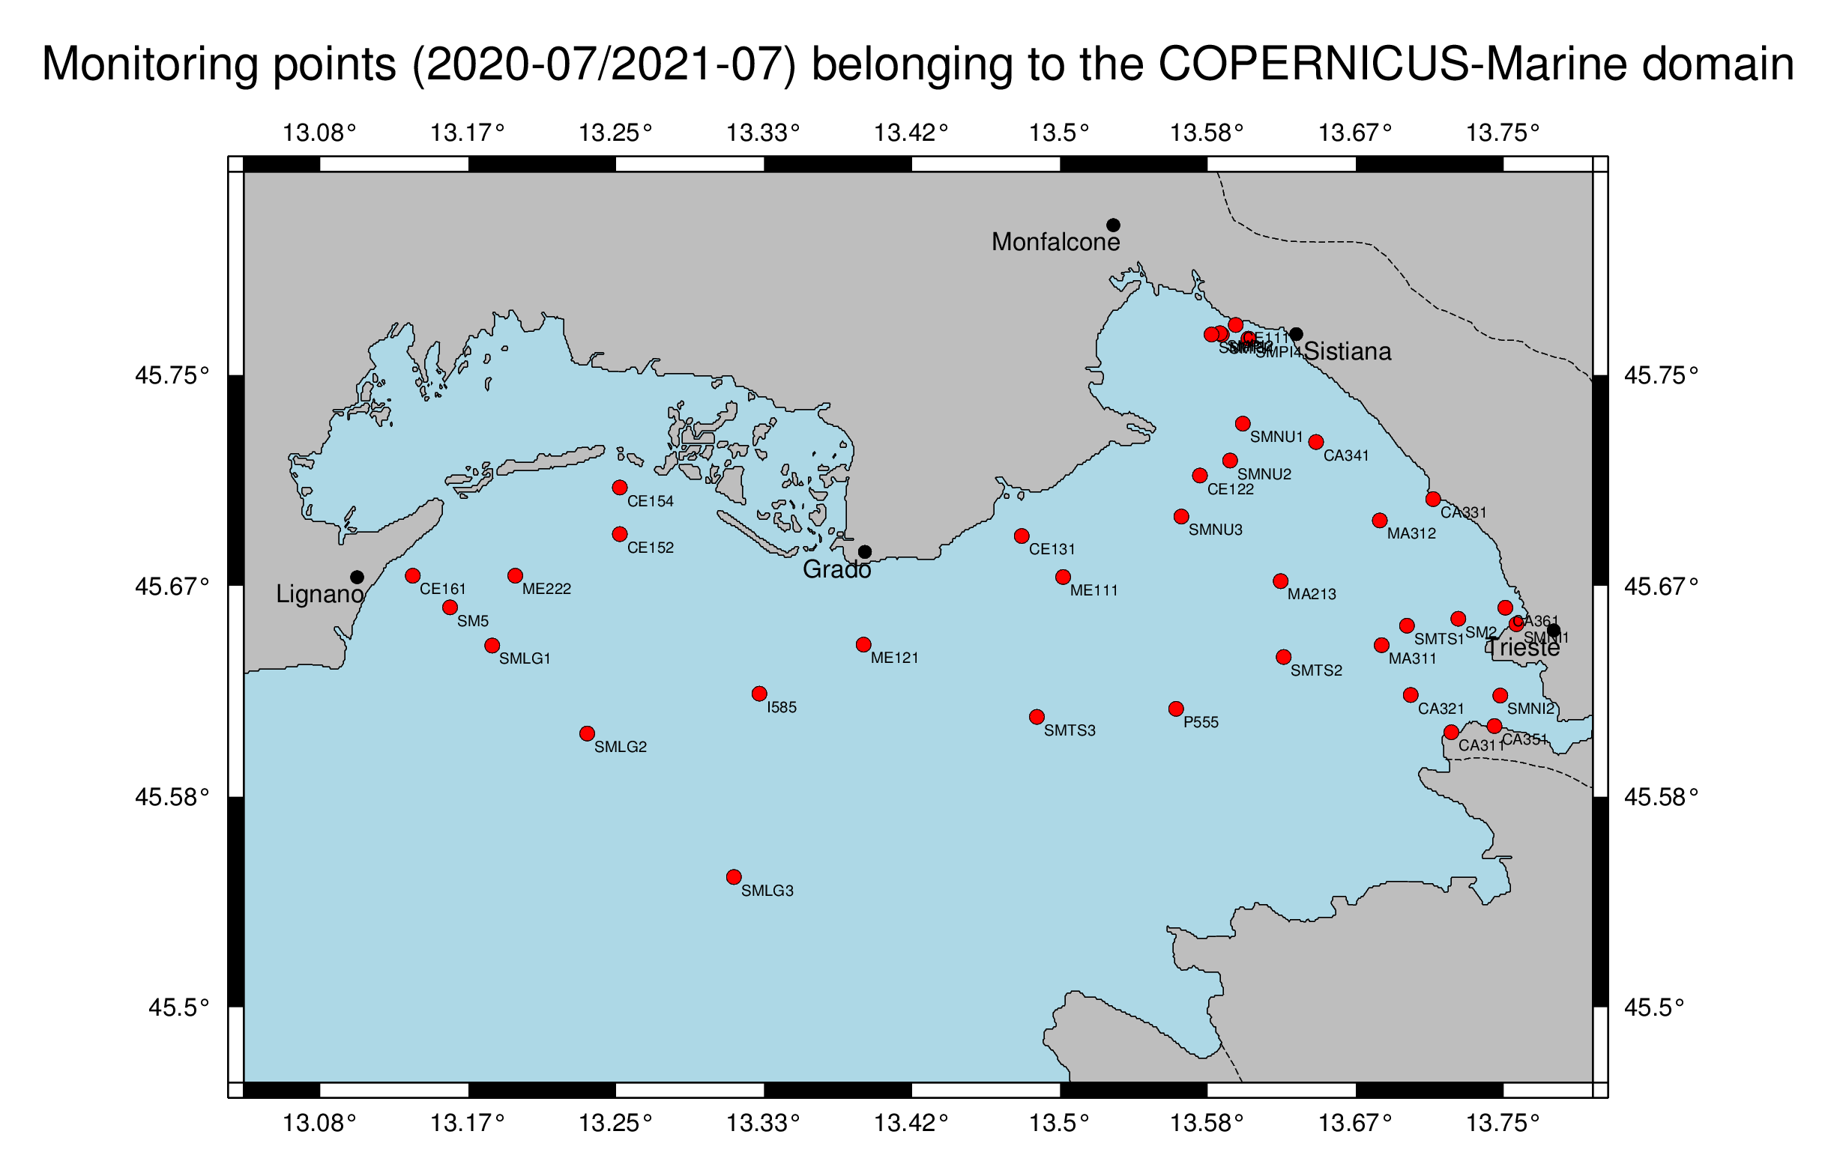
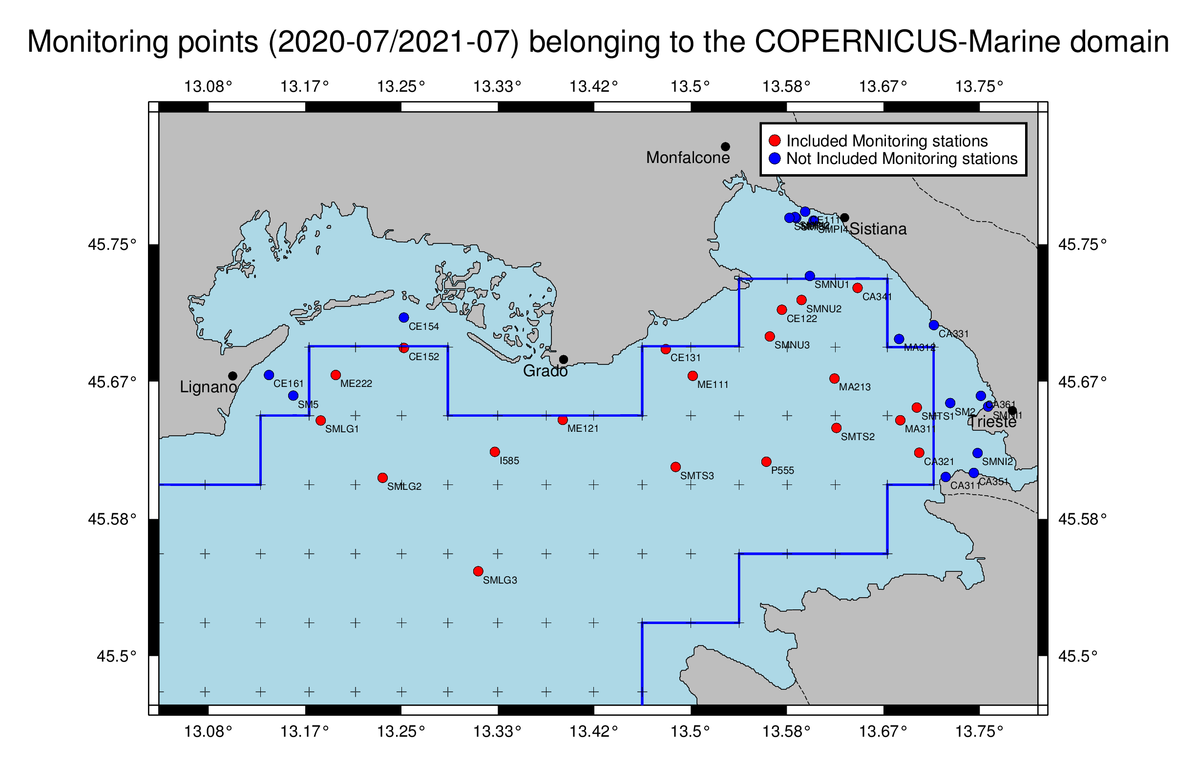
Entire set of monitored points from 07/2020 to 07/2021

Slide 5
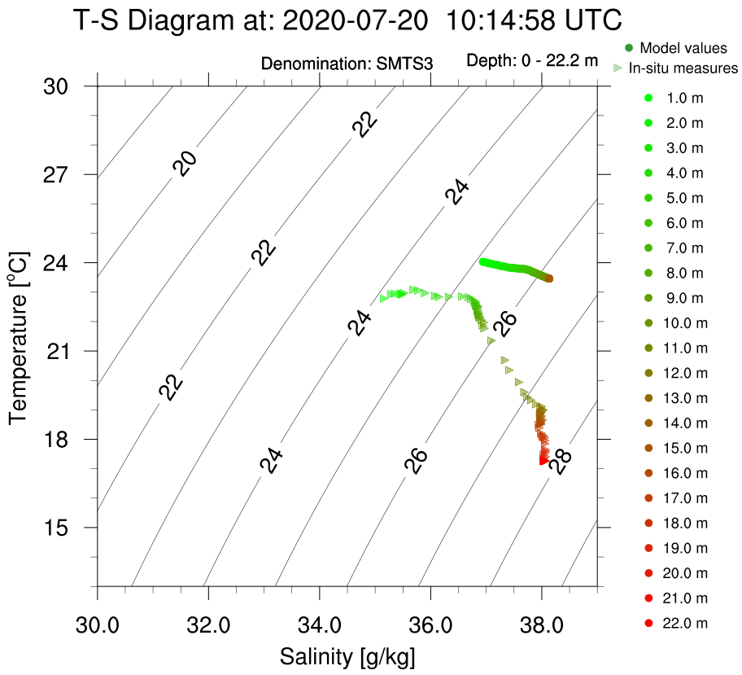
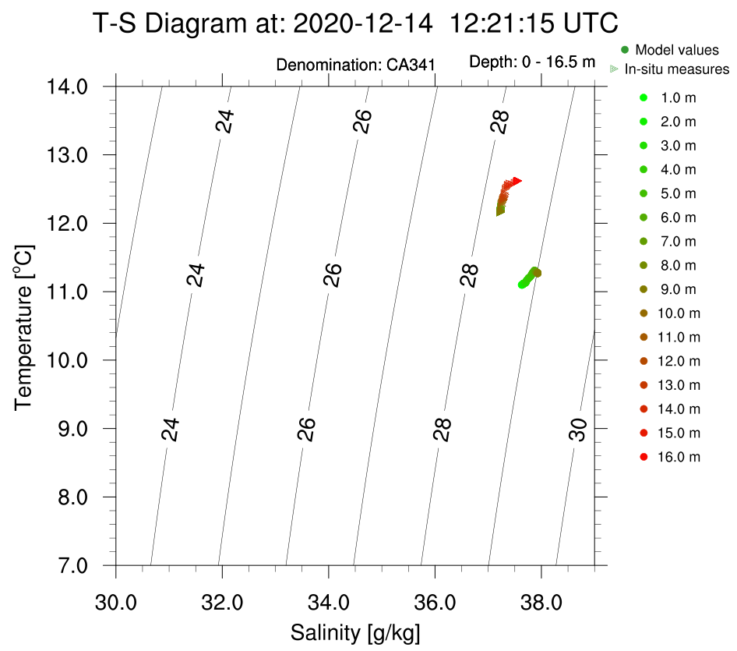
TS-Diagrams

Slide 6
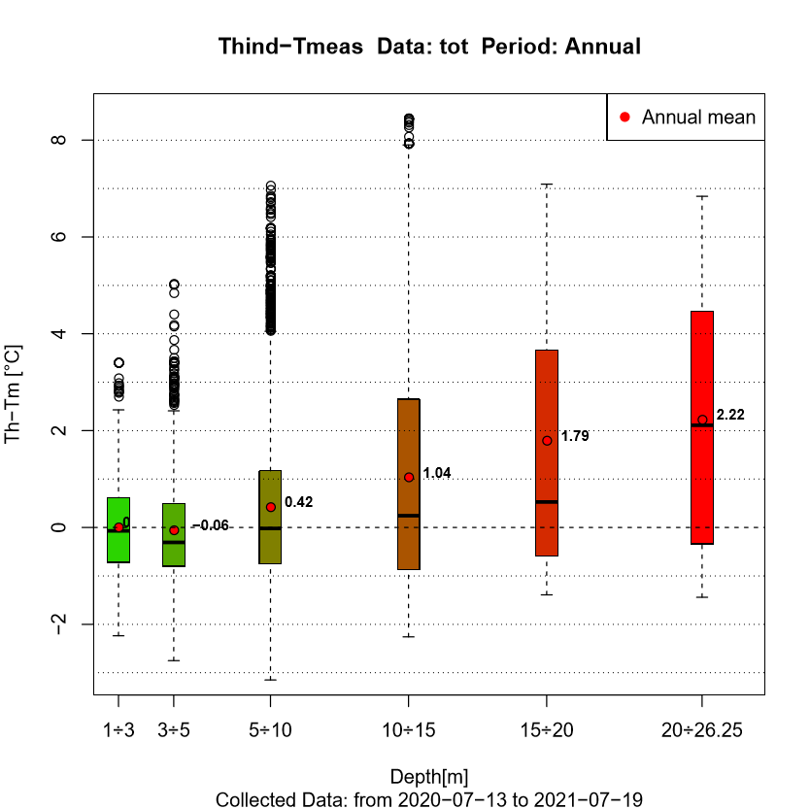
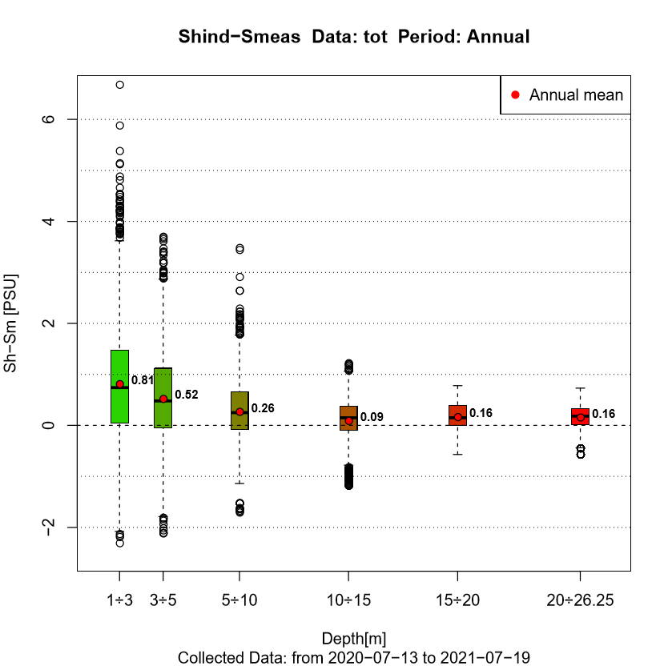
Entire domain boxplots

Slide 7
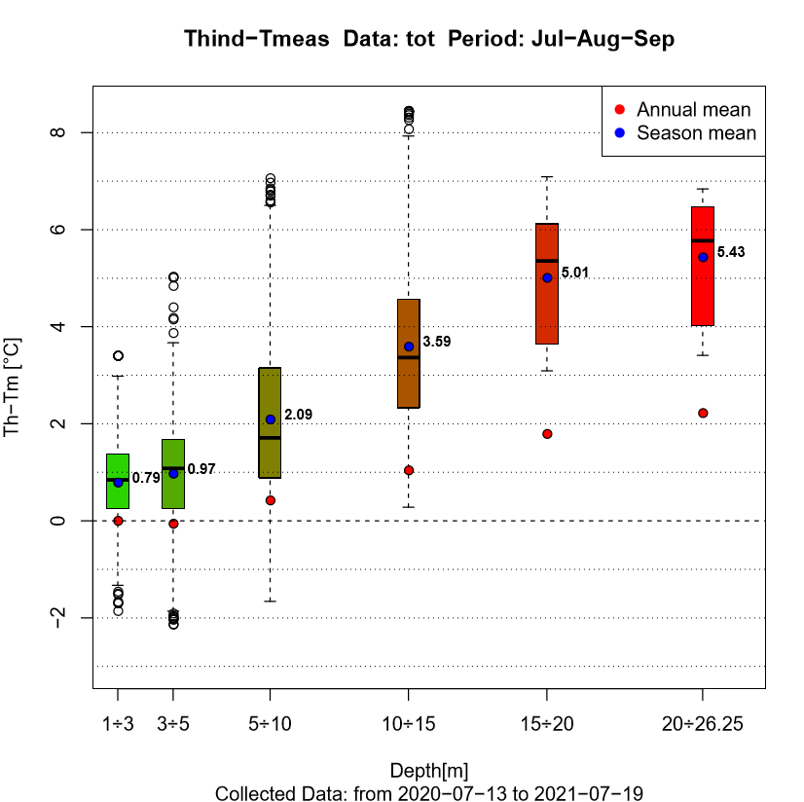
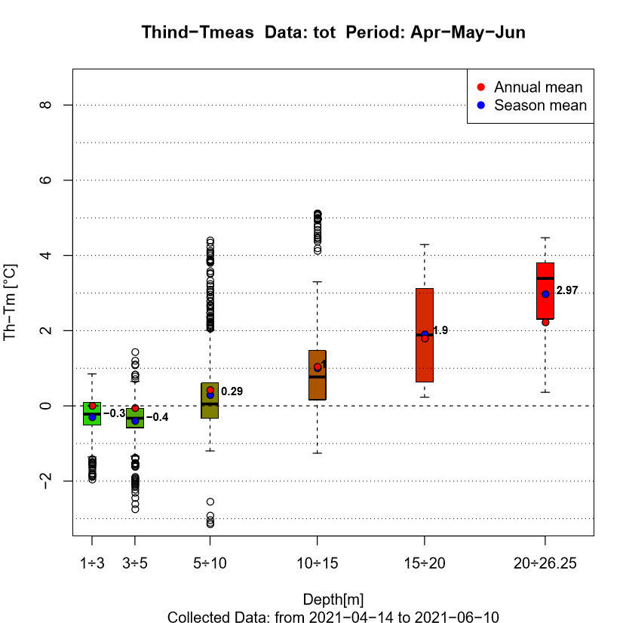
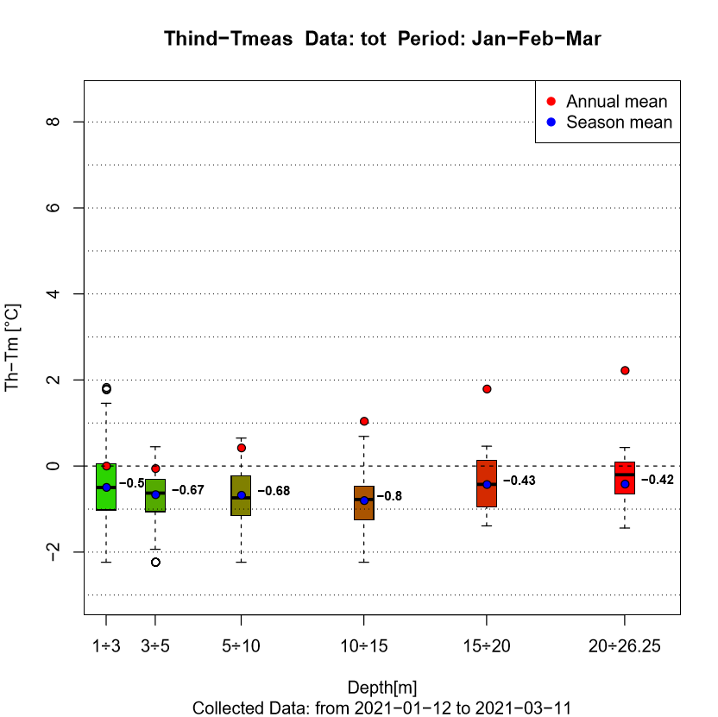
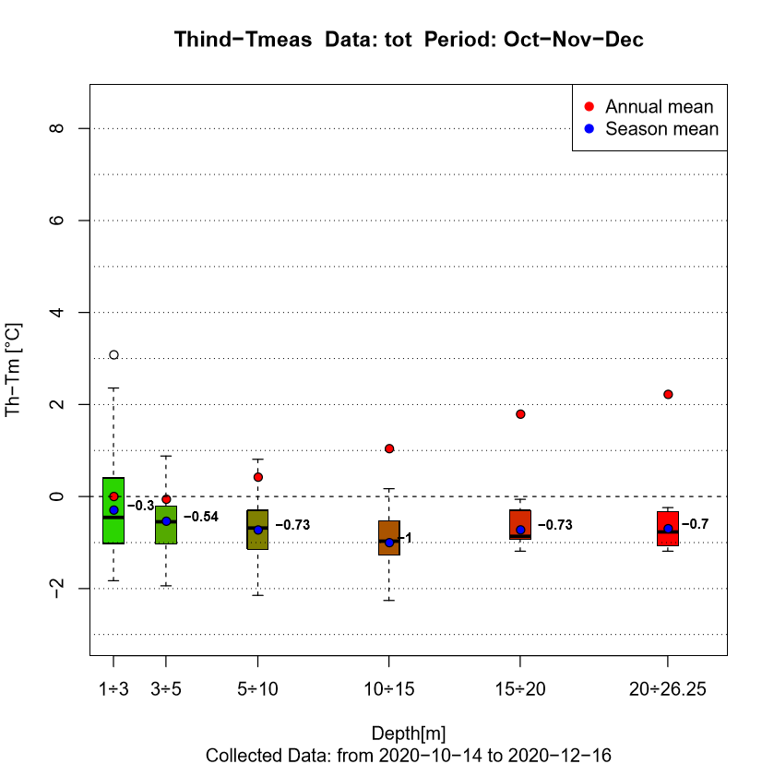
Temperature entire domain for different seasons: Jan-Feb-Mar Apr-May-Jun Jul-Aug-Sep Oct-Nov-Dec

Slide 8
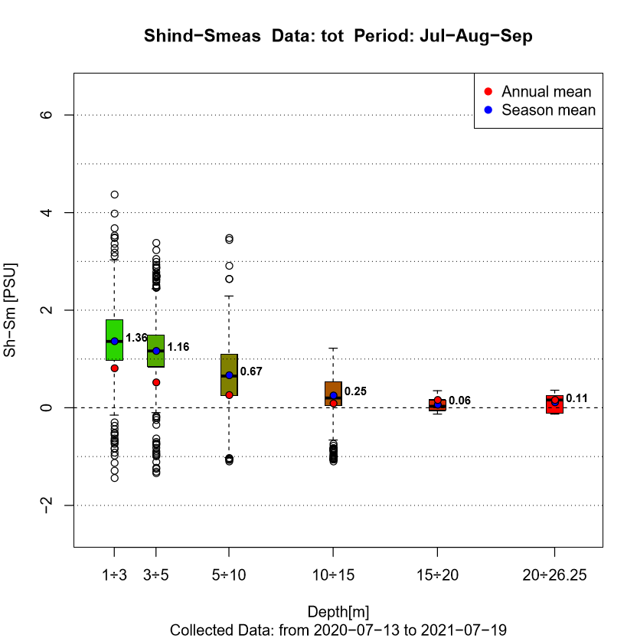
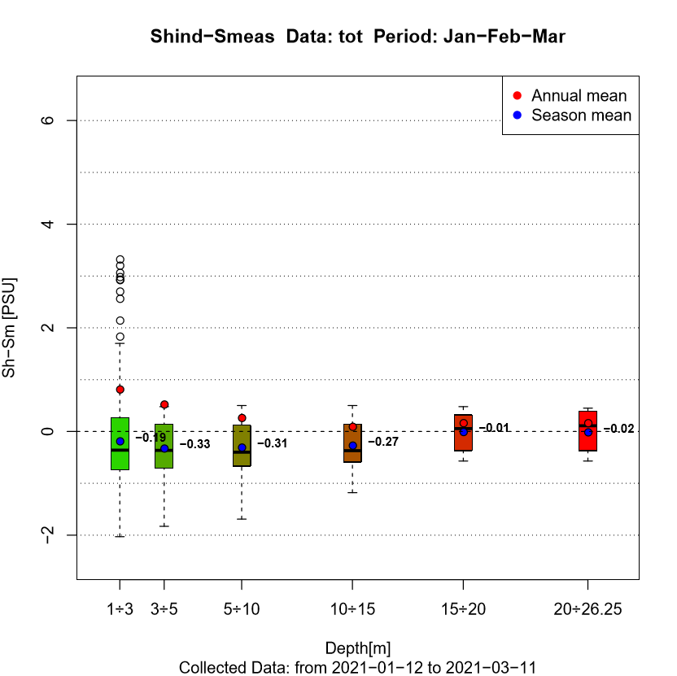
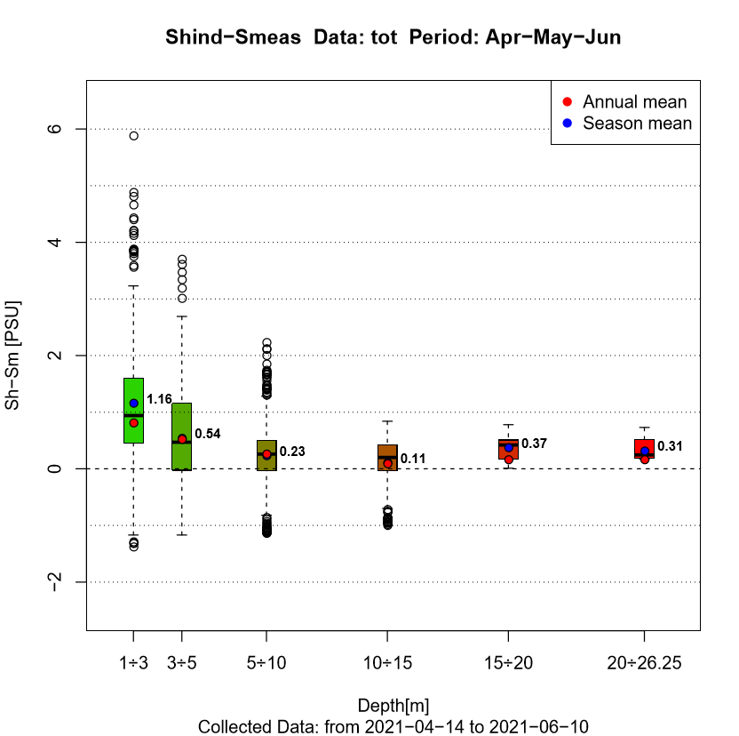
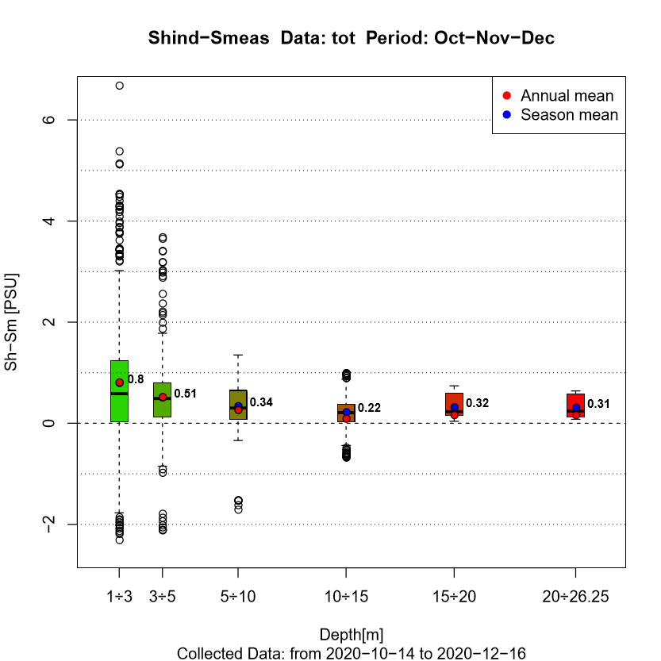
Salinity entire domain for different seasons: Jan-Feb-Mar Apr-May-Jun Jul-Aug-Sep Oct-Nov-Dec

Slide 9
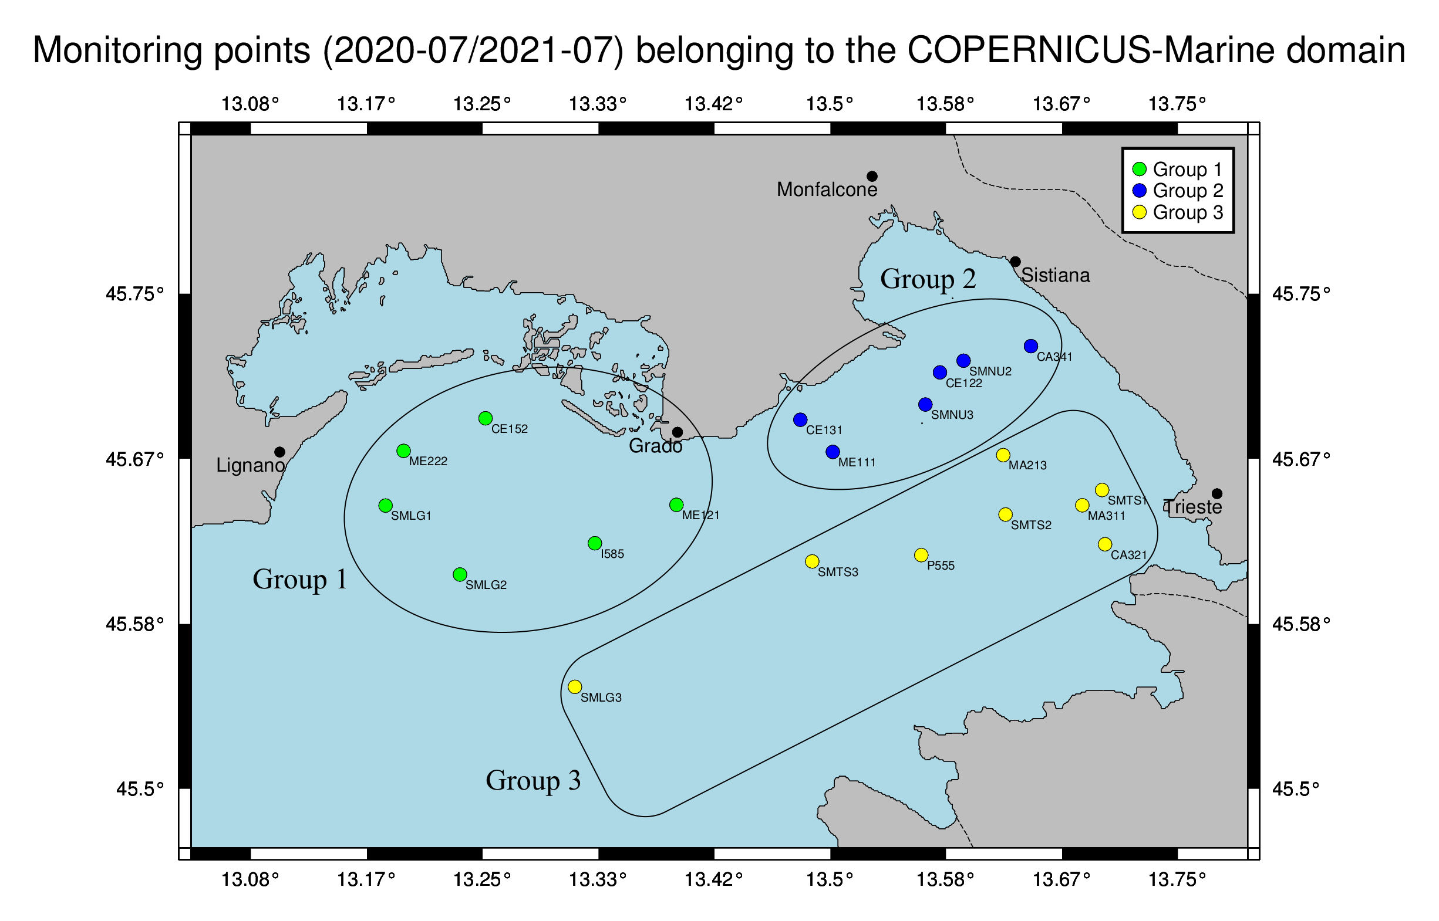
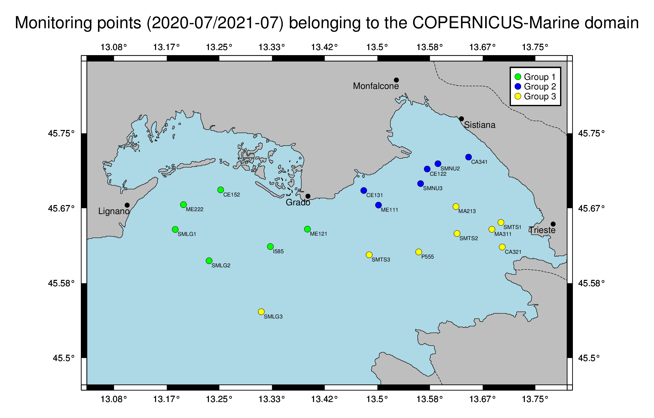
Spatial selection: group1 group2 group3

Slide 10
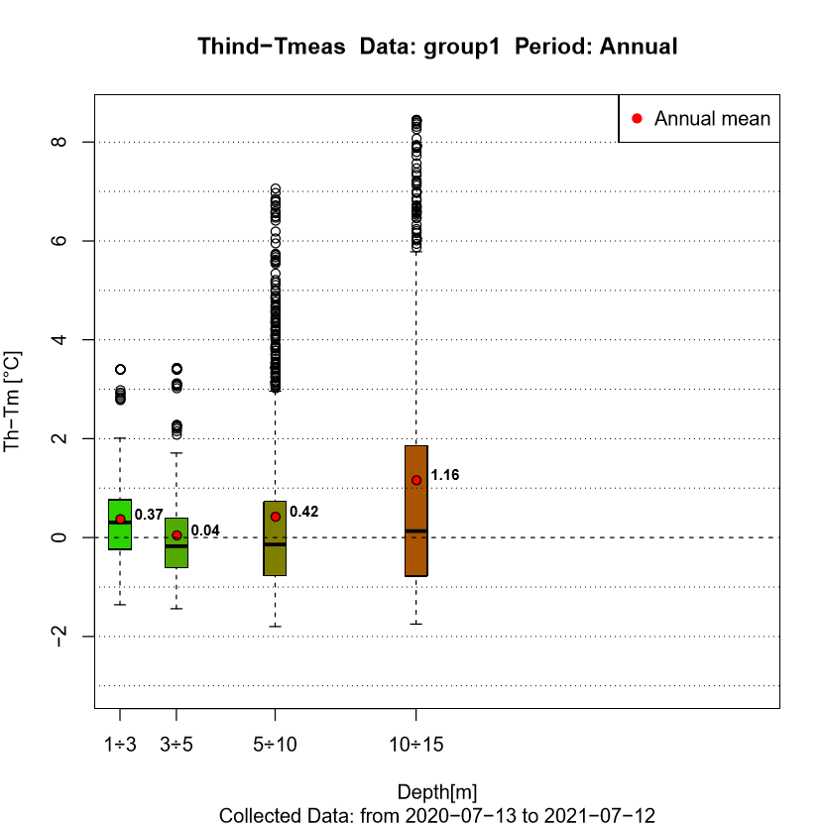
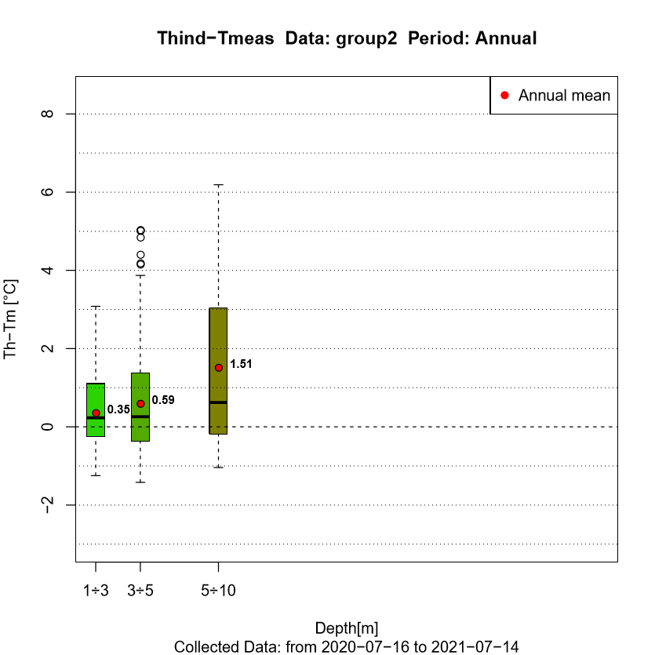
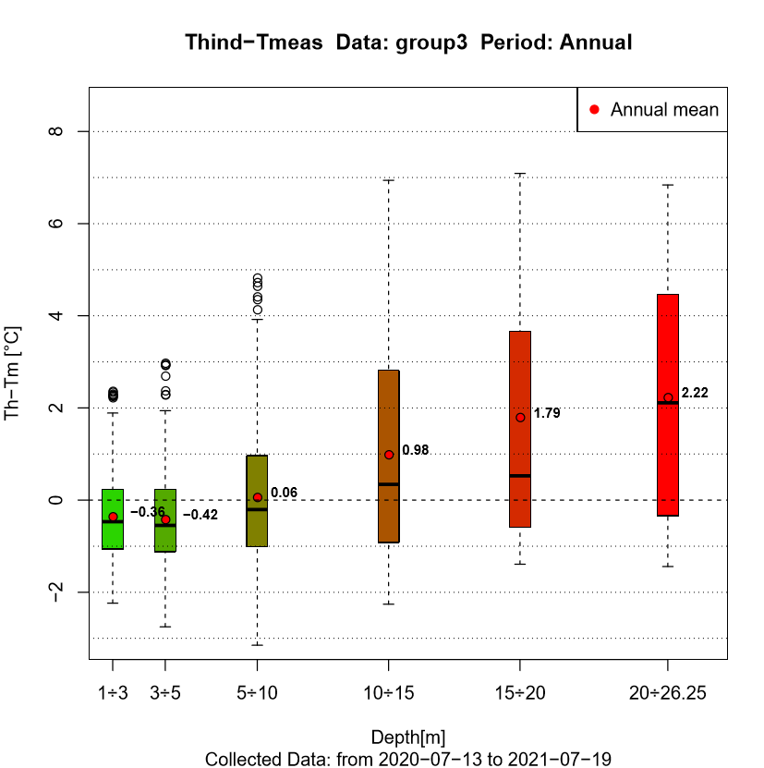
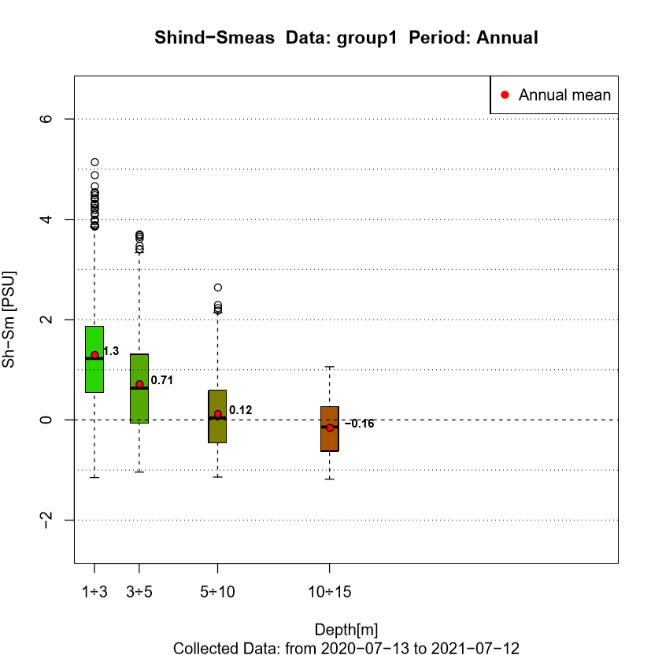
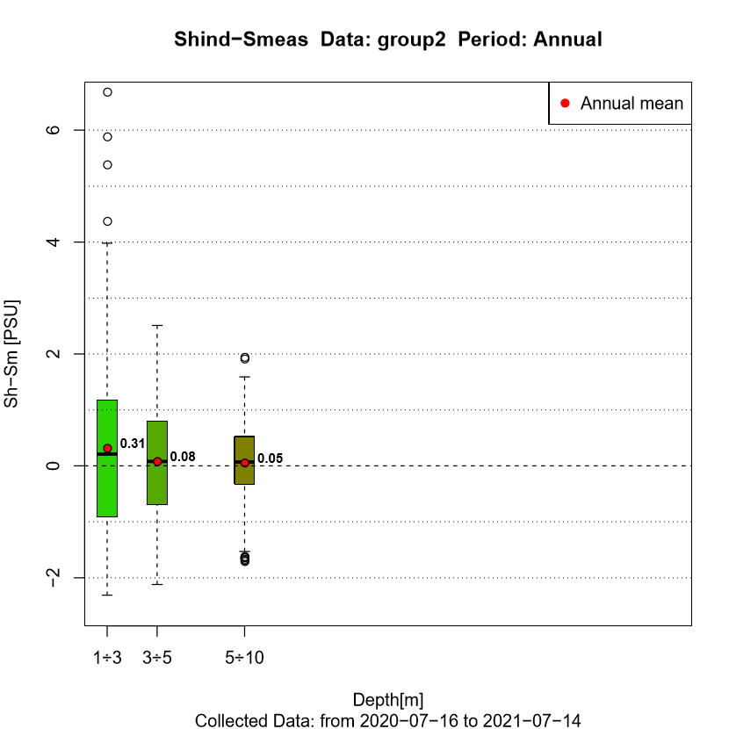
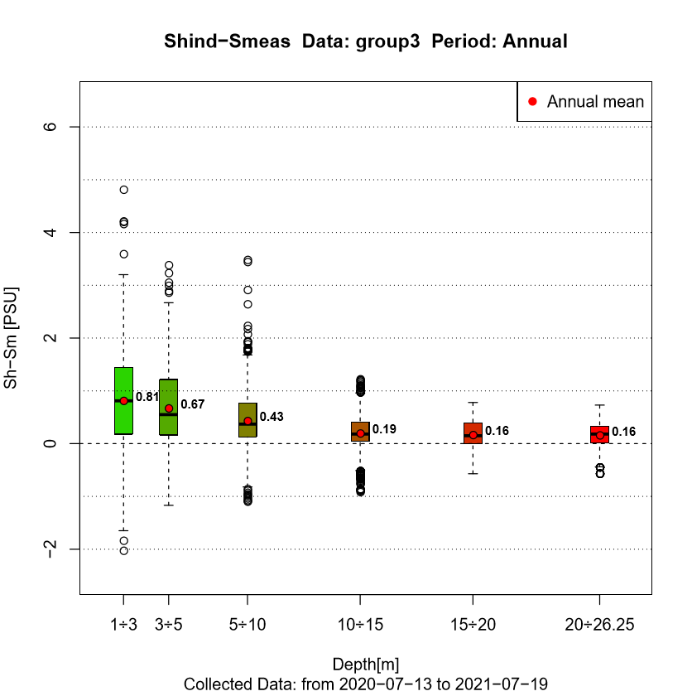
Group1 Group2 and Group3 for the entire annual period
Group 1
Group 2
Group 3

Slide 11
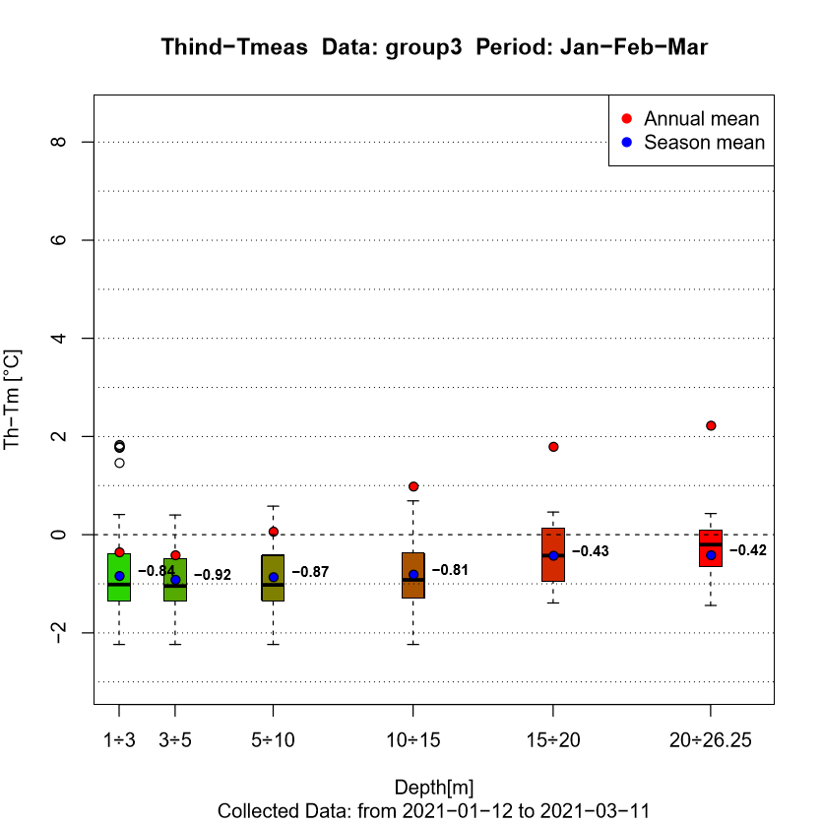
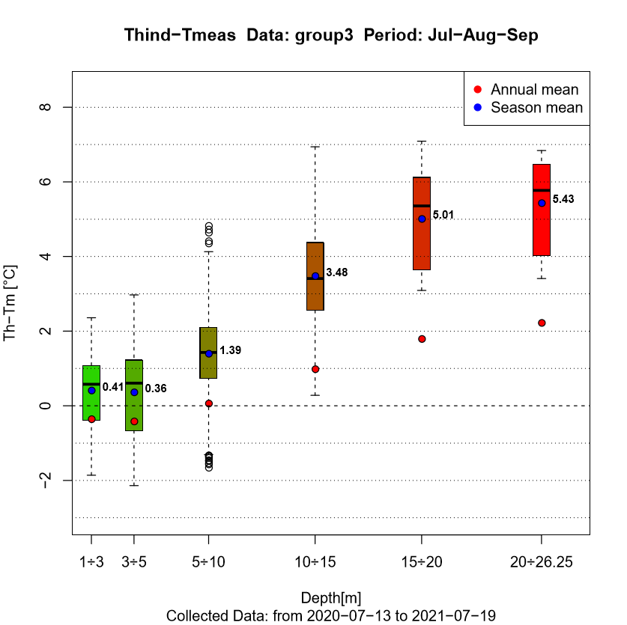
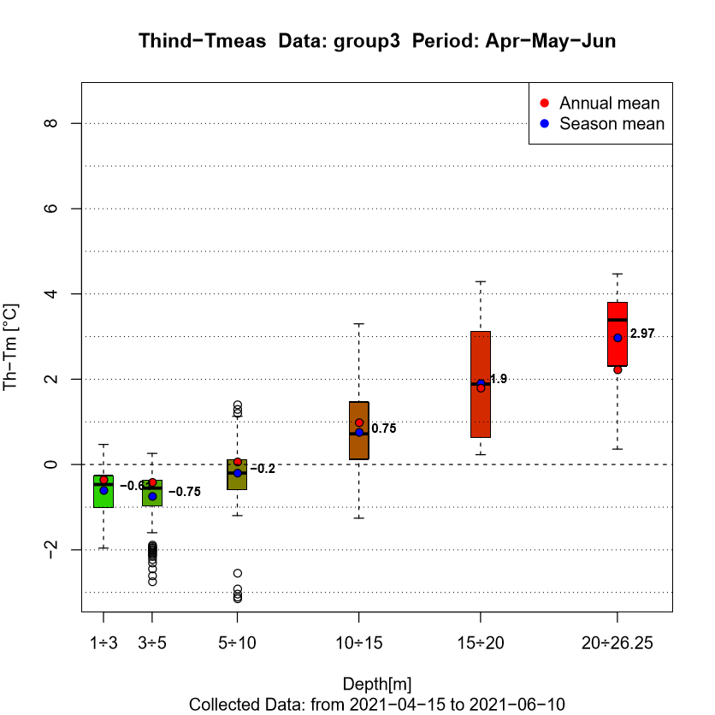
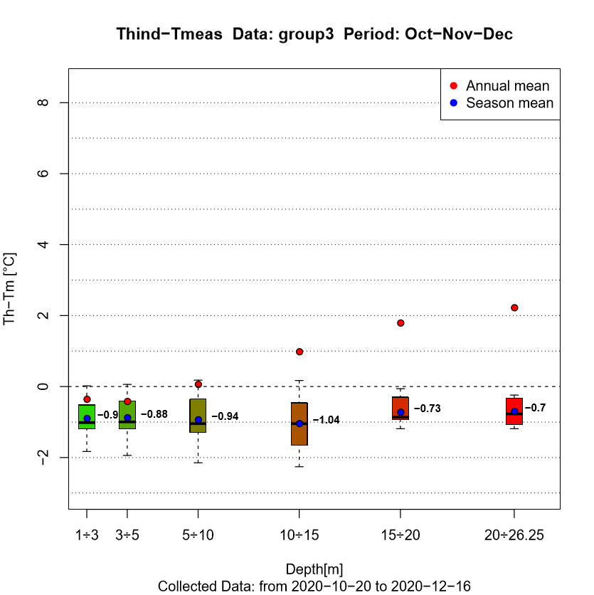
Group3 Temperature seasons comparison

Slide 12
t-test for group1 group2 and group3
Hypothesis testing compatibility for Tmodel – Tmeasured (Smodel - Smeasured) with a μ=0 mean value. A two sided test has been performed.
H0
Null Hypothesis
H1
Alternative Hypothesis
α=0,05
True mean
is equal to 0
p-value > 0,05
p-value < 0,05
True mean
is not equal to 0
Absence of a bias
Presence of a bias
α is the probability of wrongly rejecting H0 when it is true, and is called the significance level of the test.
p-value represents the probability of exceeding the measured value
In the usual practice if the p-value is smaller than some predefined level ( 5% according to the Fisher prescription ), the null hypothesis is rejected.

Slide 13
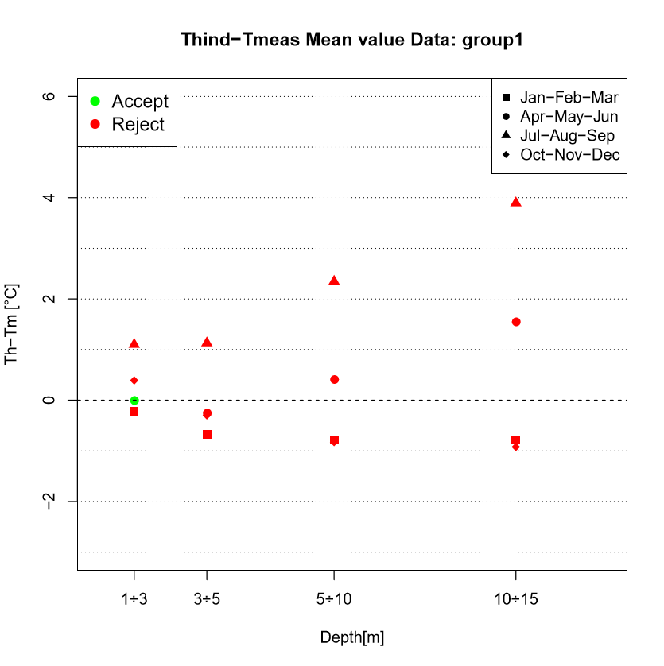
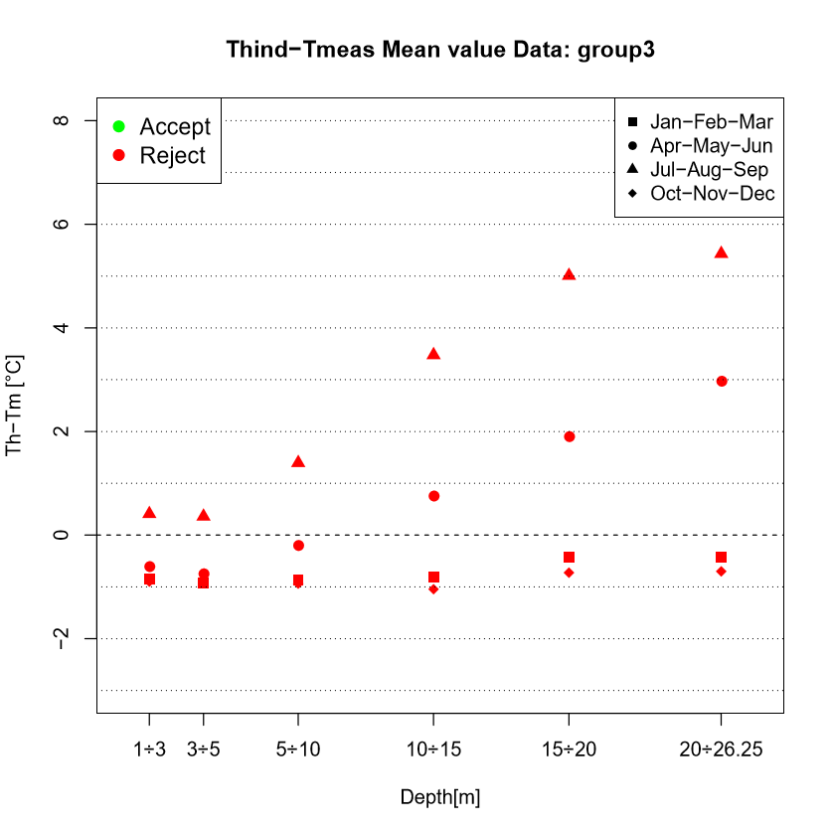
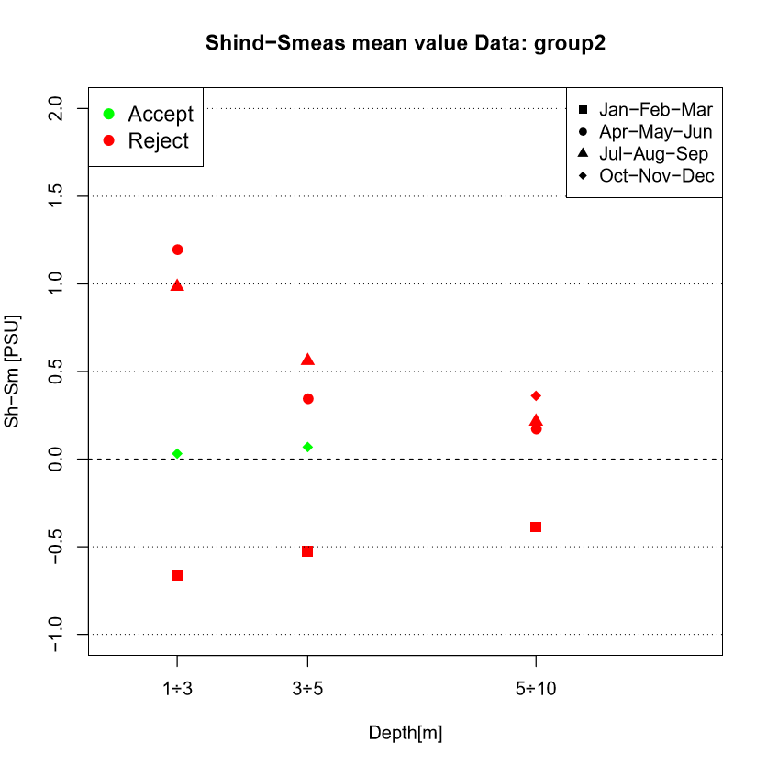
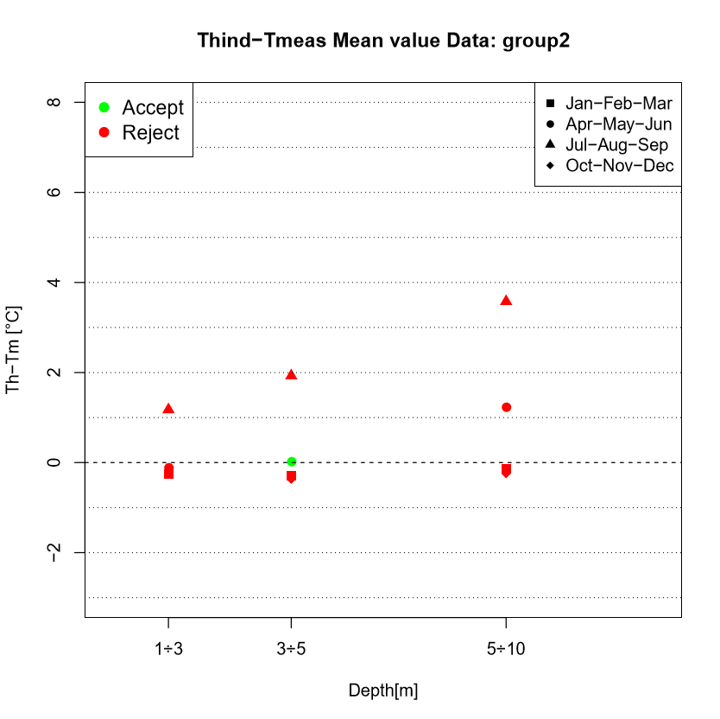
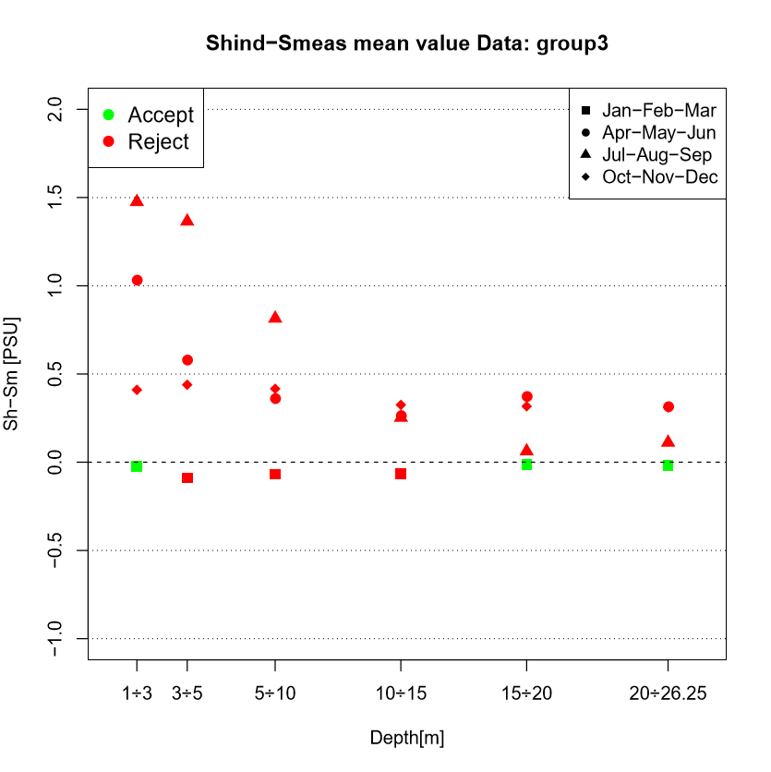
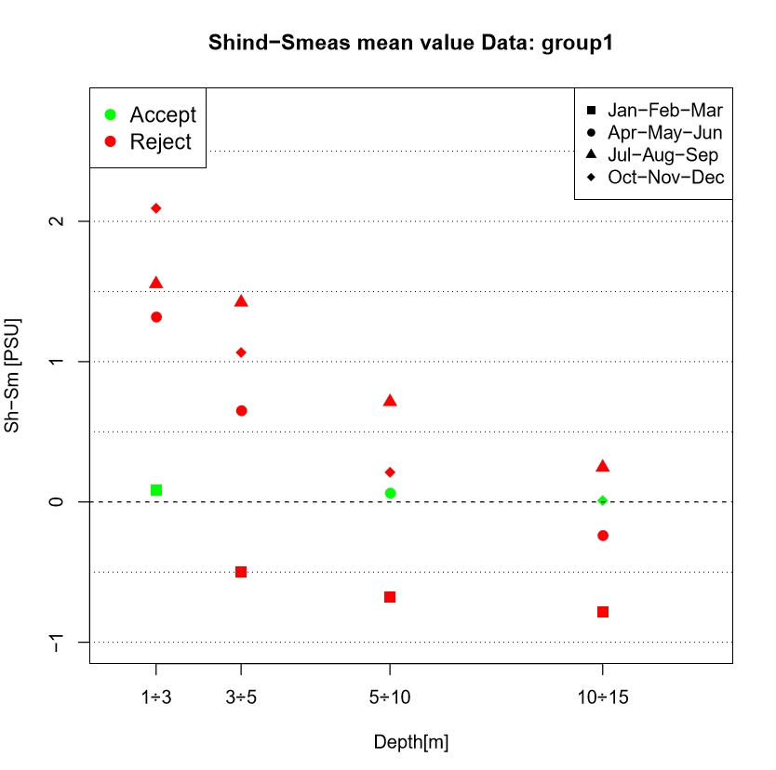
Mean value and t-test results for groups in different seasons
Group 2
Group 1
Group 3

Slide 14
Foreseen next activities and further developments:
Web Page interface for graphic and analysis sharing
Analysis on the SHYFEM simulations in Marano-Grado lagoon
Analysis extension over years (2014-2019)
Time series correlation with Taylor diagram summary
Extension of analysis including further Adriatic monitoring stations
Quality evaluation of CMEMS and SHYFEM Forecasts

Slide 15
CONTACT INFORMATION
Partner Name: ENVIRONMENTAL PROTECTION AGENCY OF FRIULI VENEZIA GIULIA (ARPA FVG )
Contact person: Alex Pividori
Via Cairoli, 14 I-33057 Palmanova (UD) - ITALY
alex.pividori@arpa.fvg.it
http://www.arpa.fvg.it

Slide 16
Approximations Needed
Flux diagram
Measured data extraction: according to time and station desired
Time linear interpolation
COPERNICUS hindcast data extraction
Depth levels interpolation:
0,25 m distance
First CMEMS depth level:
from 1,02 m to 1,00 m
Depth ranges selection:
1÷3 3÷5 5÷10
10÷15 15÷20 20÷26
Bilinear interpolation along latitude and longitude
Data Plotter

